Slide 1

Branch Dueling Deep Q-Networks for Robotics Applications
Master’s Thesis
Baris Yazici
Msc. Mahmoud Akl
Technical University of Munich
Computer Science Faculty
Chair for Robotics, Artificial Intelligence
and Realtime Systems
Munich, 22.09.2020

Slide 2
OpenAI Gym-based Grasping Environment
Training with different modules:
Curriculum Strategy
Input and Reward Normalization
Shaped Reward
Encoder, depth and RGB-D perception

Slide 3
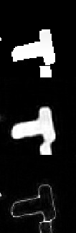
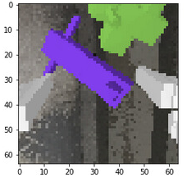
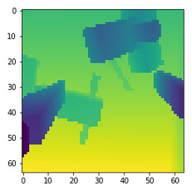
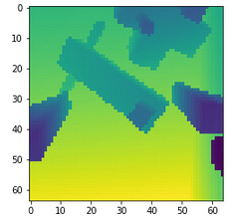
Experiments with Different Perception Layers
Auto-encoder
Depth
RGB-D
Real Image
Recons-
tructed
Error

Slide 4
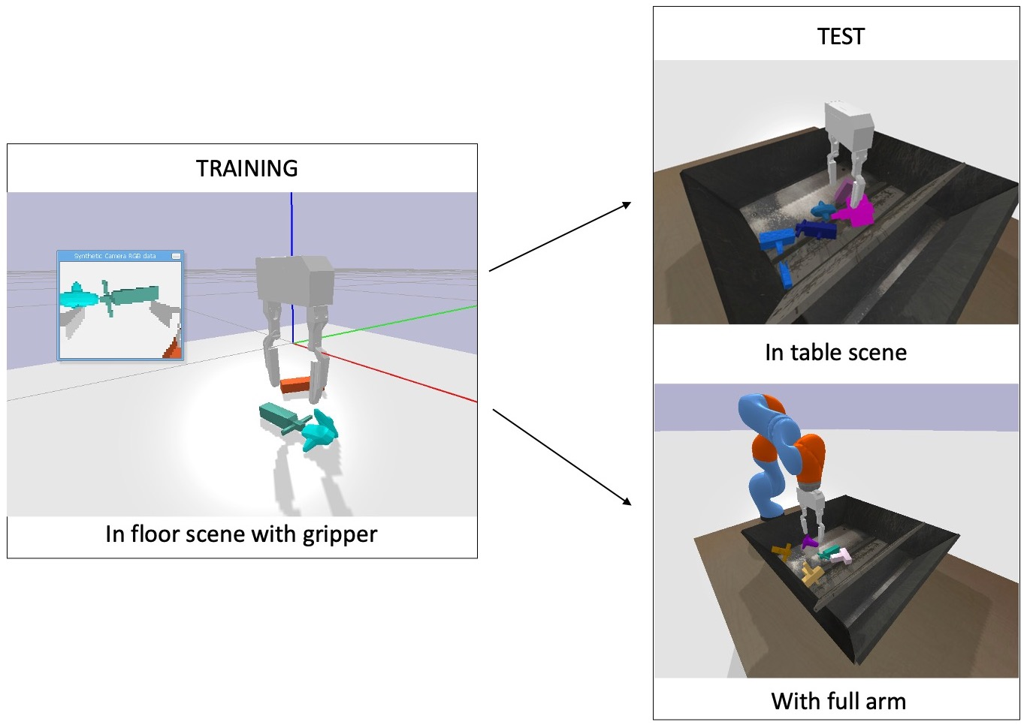
Training and Test Pipeline
New scene
New Domain

Slide 5
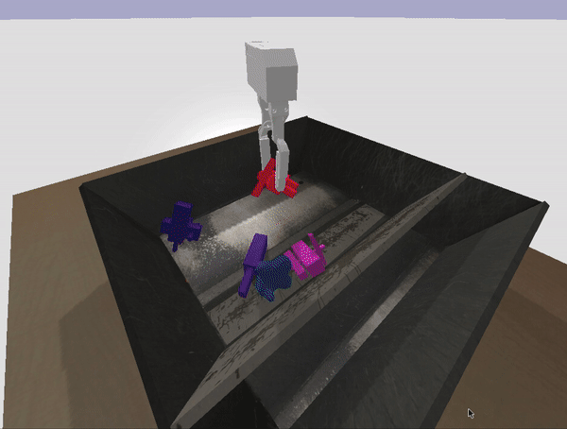
SAC Test Results on Gripper Environment
Table 1: SAC test results on gripper environment with new scene and objects set

Slide 6
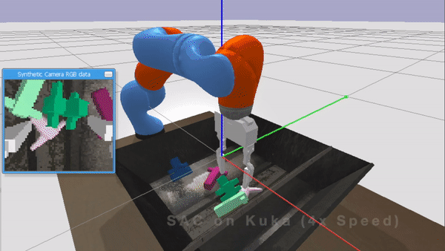
SAC Model Domain Transfer to Kuka
Table 2: SAC model transfer to Kuka domain

Slide 7
SAC Plots– Perception Comparison

Slide 8
SAC Encoder Result

Slide 9
SAC Ablation Studies

Slide 10
SAC Ablation Studies

